Slide 1

ATOM.AI Chart of Accounts
February 2022

Slide 2
Objective
AI within Atom Space
Leveraging the Predictive Model for baseline mapping
Understand the AI-Atom model
Q&A

Slide 3
We are utilizing AI models to transform Digital Controllership
Advanced AI/ML solutions strengthen the integrity of an organization’s financial processes & systems, and drives the ability to evolve with environmental changes
HOW AI CAN ENABLE THE CONTROLLERSHIP FUNCTION
From
To
High levels of human effort and disjointed processes
Systematic, global approach to insight and value generation
Deep Learning : AI models pull and learn from qualitative sources such as financial reports, textual feedback, or survey comments to extract meaningful information around financial operations
Augmented Decision Making: AI models provide novel findings to enhance human decision-making and overall reduce risks
Continuous Monitoring: Self-provisioning technology works on a continuous basis to provide a real-time, forward-focused approach
1
Heavy manual processing environment
1
Refocused resources to activities with a greater value or higher priority
AI/ML Enablement
Heightened degree of business flexibility and streamlined processes
2
Variability and potential for human error
2
AI Technique Spotlight
3
General, industry-agnostic approach
3
Increased human decision making through industry-specific insights
Multilayer Perceptron
Sequence2Sequence
4
Reduced processing speeds
4
Optimized processing speeds
Deep Learning on Tabular Data

Slide 4
Controllership | Chart of Accounts Mapping
Apply AI/ML to predict novel mapping of chart of accounts
Background
Outcomes
ATOM is Deloitte Risk and Financial Advisory’s proprietary master data design + mapping transformation service that can help organizations link multiple sets of complex finance data models to realize greater automation, control, and flexibility.
ATOM is used to integrate the design, mapping, reconciliation and change tracking of organizations’ chart of account and financial data object transformations.
Deloitte’s solution will:
Provide advanced AI/ML capability by integrating within existing Deloitte/related assets such as ATOM, etc.
Reduce manual effort required in mapping of accounts across financial systems during system transformations
Generate industry/sector level insights to recommend chart of accounts mapping best practices
Identify duplicate/unused accounts to ensure good financial reporting/recording hygiene
Provide self monitoring to ensure chart of accounts mapping adheres to best practices/industry standards after financial transformation
1
2
3
Solution
The model will:
Take as input the existing Global Chart of accounts (account description + hierarchy) from any legacy system (MS Dynamics, Oracle, SAP etc.) and predict a mapping to new system (S4)
“Translate” account hierarchies and mappings from legacy
system to modern system
4
1
5
2

Slide 5

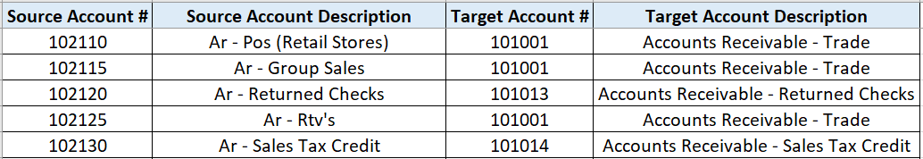
Data Overview
Data contains the source account descriptions and target account descriptions mapped using the source account number and the target account number (or Account to Account Mapping) as below:
Data used for training the model includes the data from various companies across industries/sectors.
Data across multiple companies contains the balance sheets and income statements as well.

Slide 6

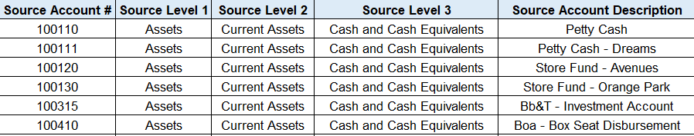
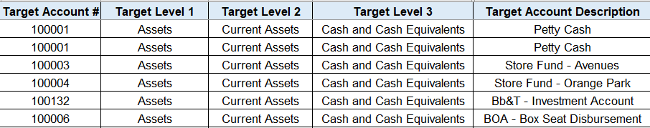
Data Hierarchy
Source and target account descriptions are organized by certain levels in hierarchy as below:
Source Account Description
|
|-- Source Level 1
| |
| |-- Source Level 2
| | |
| | |-- Source Level 3
Target Account Description
|
|-- Target Level 1
| |
| |-- Target Level 2
| | |
| | |-- Target Level 3

Slide 7

Data Mapping
Not every company have the data on the hierarchy level, they just have the source and target account descriptions.
Based on the data provided, our solution focus on the below 2 mappings –
Short to short mapping:
Long to long mapping:
Short
(Source Account Description)
Maps to
Short
(Target Account Description)
Long
(Source Account Description with hierarchical data)
Maps to
Long
(Target Account Description with hierarchical data)

Slide 8
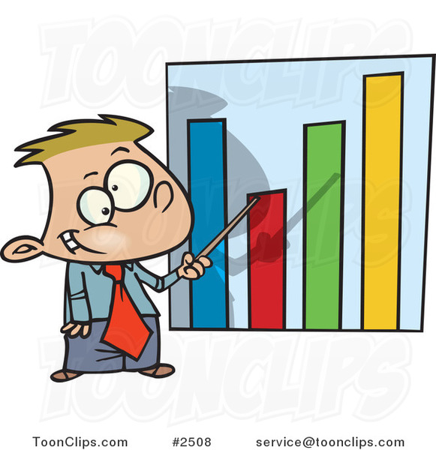
Data Analysis
The provided data is distributed across different industries and source ERP as below:
Following chart shows the split of the data based on hierarchy level.

Slide 9
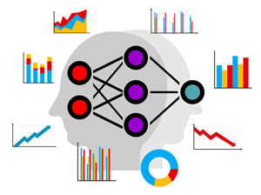
Model Use Cases
Below bar charts shows the data split across BS (balance sheet) and IS (income statement).
This is the pre-alpha release of the solution and currently have 4 use cases:
Balance Sheet
|
|-- Short to Short mapping
|
|-- Long to Long mapping
2. Income Statement
|
|-- Short to Short mapping
|
|-- Long to Long mapping

Slide 10
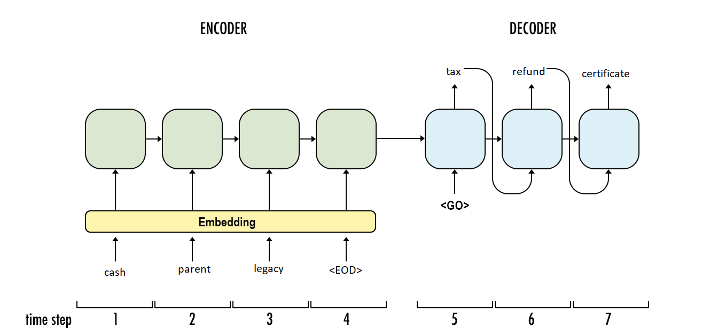
AI Model Architecture
Model Name | What will it do? | Output
Sequence to sequence (seq2seq) translation model: Encoder-decoder based architecture mapping sequence of input text to sequence of output text Embedding and GRU layer Attention decoder | The model will: Read the source account description (with or without hierarchy level data) and tries to generate the target account description based on the input provided. | The model generates: List of target account descriptions with hierarchy levels, or without levels depending on the user input. Considerations: Client data is organized in the same format across all companies. The data may or may not have hierarchical level of information.
ILLUSTRATION:

Slide 11
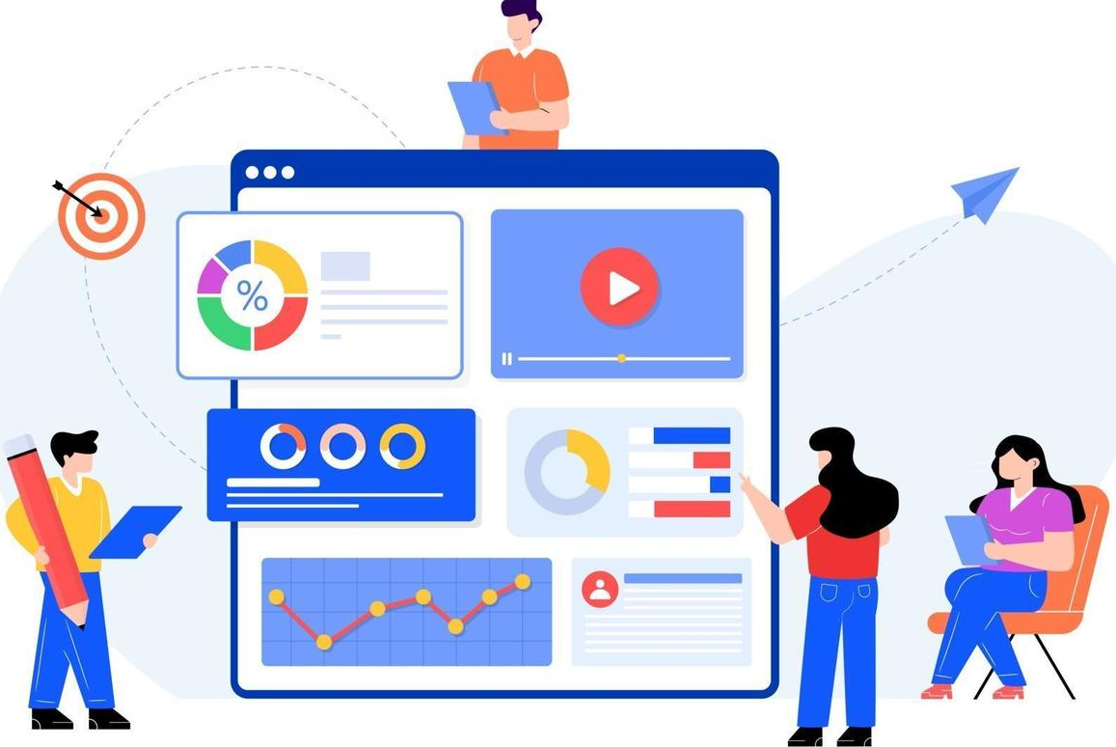
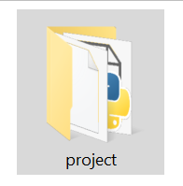
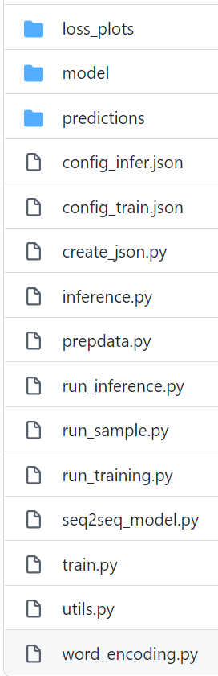
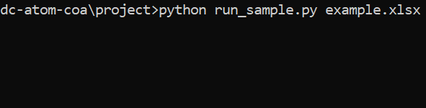
Project Overview
Code is implemented in Python language and framework used is Pytorch.
PyTorch is one of the most popular deep learning libraries.
Running the setup script creates a virtual environment on your machine to run the solution.

Slide 12
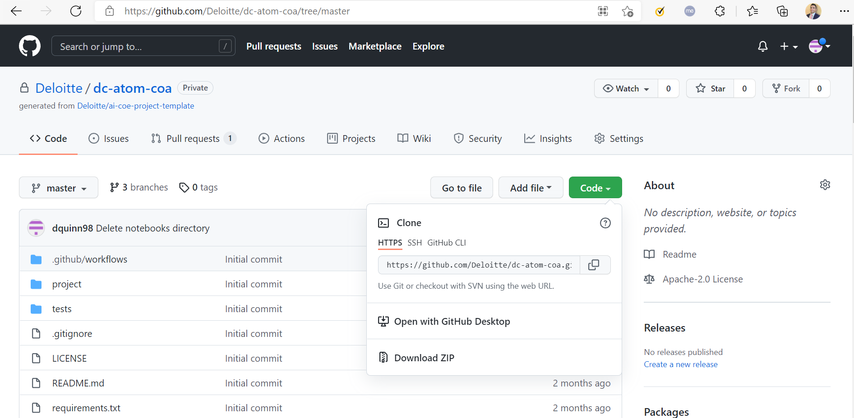
Getting Started – Download the Repository
In a web browser, navigate to https://github.com/Deloitte/dc-atom-coa/tree/master
Under Code, select Download ZIP and unzip file to desired location

Slide 13
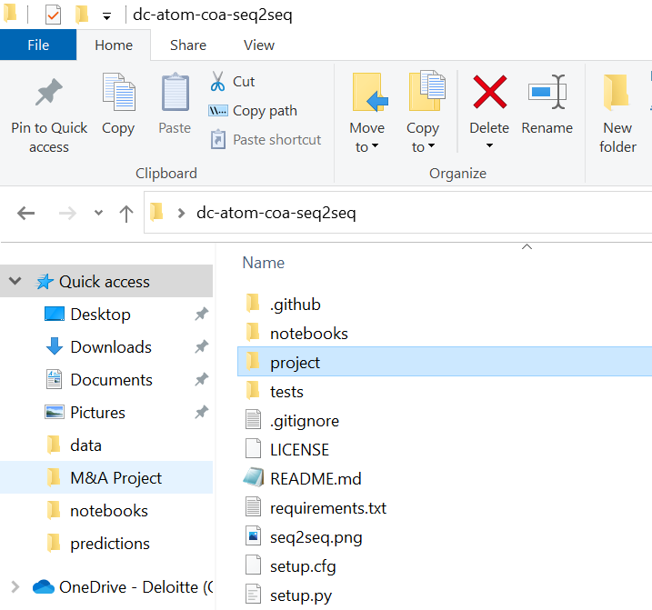
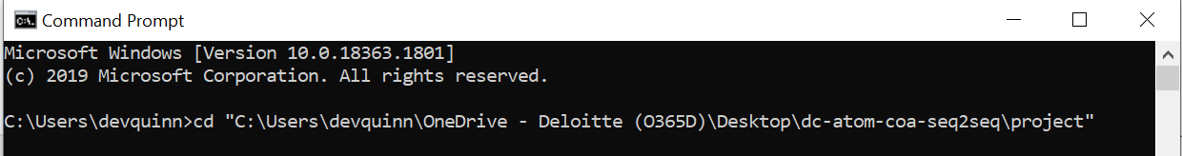
Getting Started – Navigate to Project Location
3. Open the created directory , select the Project folder and copy the path
4. Open the Windows Command Prompt and navigate to the project directory by typing "cd" and paste the copied path

Slide 14
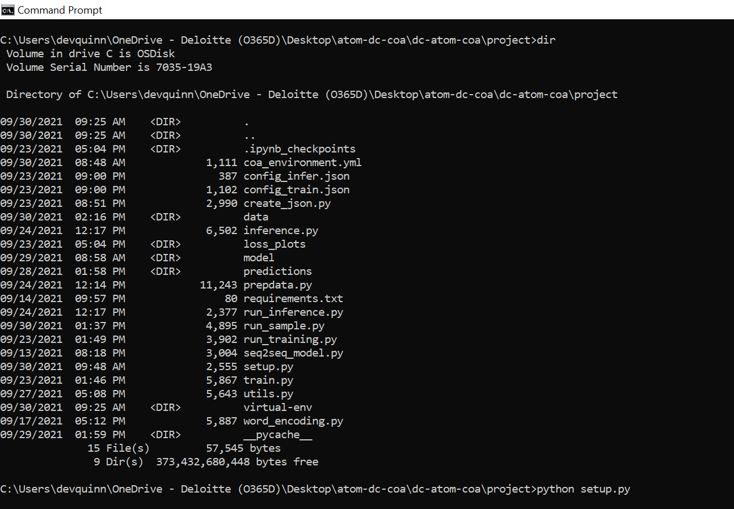

Getting Started – Check Your Location
5. Once you have navigated to the project folder in the Command Prompt, confirm you are in the right location by typing "dir" to list your current directory's files. The output should look similar to the adjacent screenshot.

Slide 15
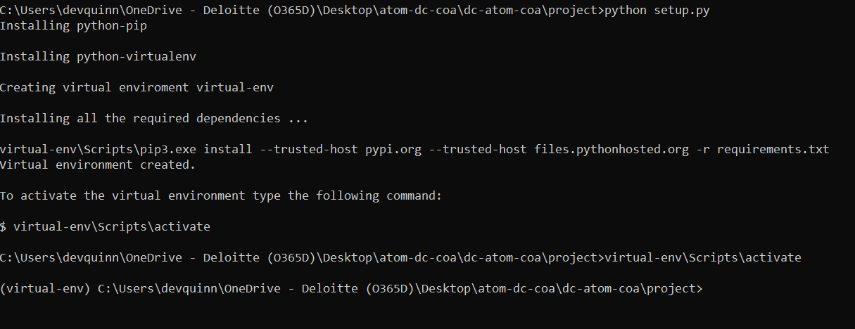




Getting Started - Setup
6. Begin installation of required dependencies by typing "python setup.py"
If this is your first time running the setup script, this will take some time
7. Once the setup script is finished, activate the virtual environment by typing
"virtual-env\Scripts\activate"

Slide 16
Running the Application – Example Demo
To run inference on a given excel file, make sure you are in the project folder and type the command "python –W ignore run_sample.py file.xlsx", where file.xlsx is the name of the file you wish to generate predicted target accounts for and is located in the data folder
Four example.xlsx files are provided showing the various types of data formats the application expects. When running the program with one of these examples, the script will automatically select the appropriate model to use (no additional user input required).
Example1.xlsx: only source descriptions
Example2.xlsx: source levels + source descriptions
Example3.xlsx: source descriptions and target descriptions
Example4.xlsx: source levels + descriptions and target levels + descriptions

Slide 17
Running the Application – Example File Formats
Example1.xlsx
Example2.xlsx
Example3.xlsx
Example4.xlsx

Slide 18
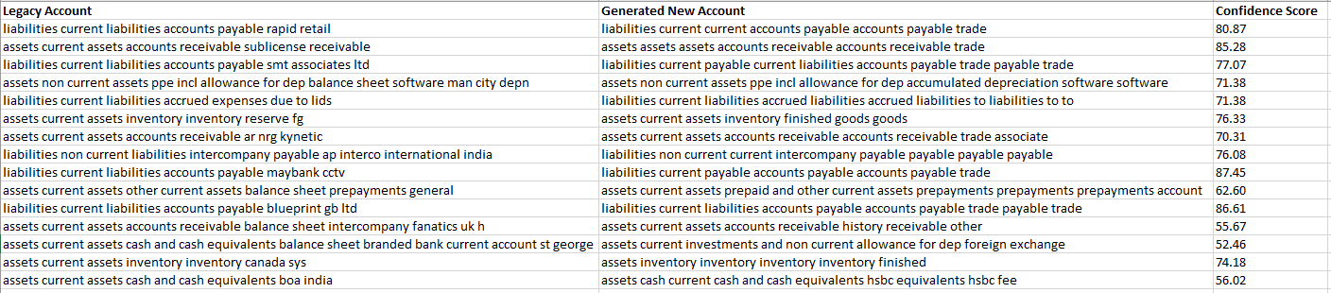
Running the Application – Example2 Results
Example2_predictions.csv

Slide 19
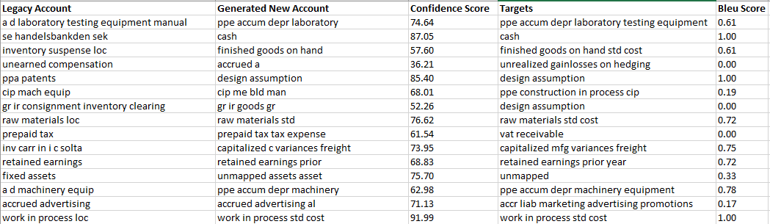
Running the Application – Example3 Results
Example3_predictions.csv

Slide 20
Running the Application – Custom File
If running the demo on a custom file, the user will be asked to specify the type of model to use:
Short Models should be selected for files with no hierarchy levels (description only) while Long Models should be used for files with hierarchy levels included.
Note: Although the minimum number of source/target levels for the Long Model is 1, it is best to use it on files with at least 3 levels in the hierarchy, as this is what was used during model training. The short model should be used for files with < 3 levels for stronger predictions.

Slide 21
Output File
After running the demo, a csv of model predictions will be saved under the predictions folder. The output file will consist of source accounts, respective target predictions, and a confidence score.
If the input file also provides ground truth target account data, the targets will be appended along with calculated bleu scores against the predictions, where a score of 1.00 is a perfect match.

Slide 22
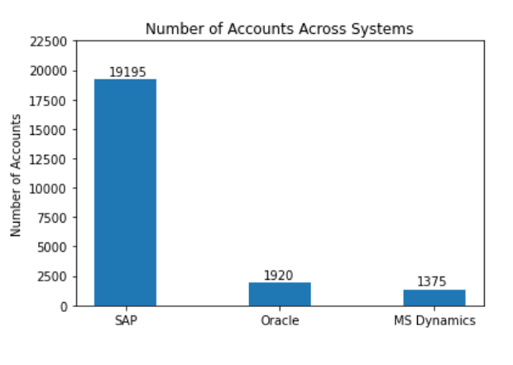
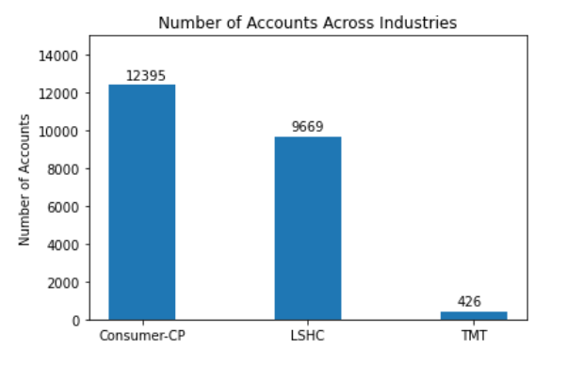
System/Industry Account Statistics – Number of Accounts
SAP | Oracle | MS Dynamics |  | Consumer-CP | LSHC | TMT
6 | 3 | 1 |  | 7 | 2 | 1
Number of companies:

Slide 23
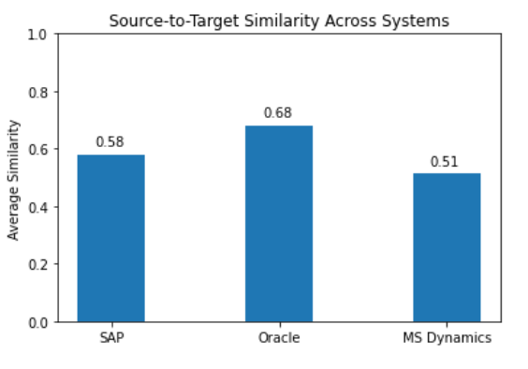
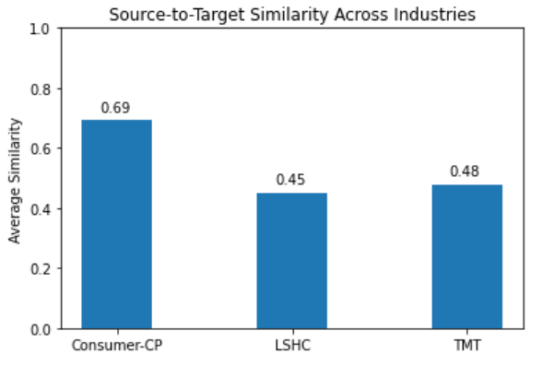
System/Industry Account Statistics – Account String Similarity

Slide 24
Metrics across Systems and Industries
Balance Sheet Accounts
Income Statement Accounts
Systems
Systems
 | SAP | Oracle | MS Dynamics
Bleu Score | 0.40 | 0.30 | 0.24
Similarity | 0.58 | 0.50 | 0.46
Confidence | 57.82% | 50.94% | 44.97%
 | SAP | Oracle | MS Dynamics
Bleu Score | 0.57 | 0.14 | 0.13
Similarity | 0.69 | 0.39 | 0.37
Confidence | 45.2% | 45.2% | 45.57%
Industries
Industries
 | Consumer-CP | LSHC | TMT
Bleu Score | 0.36 | 0.42 | 0.25
Similarity | 0.56 | 0.59 | 0.45
Confidence | 55.66% | 57.73% | 49.48%
 | Consumer-CP | LSHC | TMT
Bleu Score | 0.25 | 0.69 | 0.14
Similarity | 0.47 | 0.77 | 0.38
Confidence | 45.6% | 45.7% | 45.2%

Slide 25
Future Roadmap
More data
Our models have been trained on small set of cross-industry data. We can expect model performance to drastically increase when trained on large subsets of data separated by industry.
Notes:
Model/technique experimentation
The alpha implementation of this project uses a standard machine translation architecture (seq2seq) that is outperformed by today's state-of-the-art models. Performance will increase as we experiment with newer types of machine translation models and techniques

Slide 26
Data Assumptions
Client data will include all the necessary information for model training
Source to target account mapping
Hierarchy levels, numbers, and descriptions of source and target accounts
Client data will be complete and consistent
All sources/targets listed in mapping sheet can be found in hierarchy sheets
Unique source/target account numbers will map to a single description
Client data will be organized in the same format across companies
One column per hierarchy level
Column names/position in sheet will be the same across different companies

